Slide 1
By the Way, You’re Teaching ____ . Classes Start Next Week!
BASIC TOOLS
FOR GRADUATE STUDENT INSTRUCTORS AND EARLY CAREER FACULTY
TO SUPPORT EFFECTIVE TEACHING AND LEARNING
Shana Southard-Dobbs, M.S. & Elizabeth Jenkins, M.S.
University of North Texas
Notes:
Feel free to contact us!
Shana Southard-Dobbs: shanasouthard-dobbs@my.unt.edu
Elizabeth Jenkins: elizabethjenkins@my.unt.edu

Slide 2
Tell us about you
What is your current instructor status?
Notes:
Note: The hyperlink goes to a poll utilized during the presentation via www.polleverywhere.com, an online polling system that can be utilized much like clickers in the classroom.
A free account accommodates up to 40 responses per poll. Trick for larger classes: have students discuss answer and respond in pairs or small groups. Works via text or web (phone, tablet, laptop).

Slide 3
Overview
Rationale
Graduate student instructors & ECF face unique challenges
Goal: easily-implemented tools
Focus:
Rapport-building
Formative Assessment
Incorporate technology

Slide 4
Building Rapport
Create a positive relationship with a class through a caring and supportive environment
Rapport assists in building mutual attentiveness, friendliness and caring, and coordination between an instructor and the students.
Has been shown to increase motivation and engage in more proacademic behaviors
Attending class
Studying for class
Attend office hours
(Benson, Cohen & Buskist, 2005; Murphy & Valdéz, 2005)

Slide 5
Building Rapport
Rapport has also been shown to increase collaborative learning in the classroom.
Collaborative learning involves working in a group to increase critical thinking and resourcefulness, among other knowledge creation goals.
The majority of students report no or very little rapport with their instructors
(Benson, Cohen & Buskist, 2005; Murphy & Valdéz, 2005)

Slide 6
Tools for Building Rapport
While it may seem that rapport is something built over time, it can begin on the first day of class
http://www.youtube.com/watch?v=TyRG85LqaJc
Talk about yourself professionally and personally
Family
Hobbies
How you got into psychology
Research interests
(Buskist & Davis, 2005)

Slide 7
Tools for Building Rapport
One personal 1st day of class tool I have found:
http://www.youtube.com/watch?v=oOK5VRehEHg
Sending a “welcome” email before 1st day increased motivation, retention and attitudes
The email included personal information rather than academic
(Legg and Wilson, 2009)

Slide 8
Tools for Building Rapport
Throughout the semester:
Express interest in students (address by name, SMILE while teaching)
Build trust (follow through on commitments, hold up your end of the “bargain”)
(Buskist & Davis, 2005)

Slide 9
Building Rapport for Online Classes
Online classes are limited by no face-to-face contact
Reduces spontaneous, casual interactions
Reduces the personal touch of interacting (nonverbal movements)
Limits knowledge of non-academic lives of students and teacher (live in different communities)
(Murphy & Rodriguez-Manzanares, 2008)

Slide 10
Building Rapport for Online Classes
Tools
Increase perceived social presence via user interface and social cues
User interface – a learning system’s ease of use/helpfulness
Social cues – presenting opportunity for social interaction
Create synchronous chatting sessions where all participants (students and instructor) are online at the same time
Reduces stress, increases motivation and sense of community
(Wei, Chen & Kinshuk, 2012; Keengwe & Belamaric Wilsey, 2012)
Notes:
Online learning environments naturally encourage asynchronous learning (everyone gets to do the work at their own pace, as long as various due dates are observed).
Studies have shown that these techniques build positive perceptions of online courses and may increase performance!

Slide 11
Building Rapport for Online Classes
Tools
Encourage students to include photos of themselves, and yourself
Have “get-to-know-you” postings at the beginning of the semester – personal interests and academic
Record yourself teaching/talking
Helps to communicate nonverbal cues – smiling, hand gestures

Slide 12
Assessing Rapport in the Classroom
Professor-Student Rapport Scale (Wilson & Ryan, 2013)
34 items, 5-point likert scale
Items cover professor friendliness, flexibility, nonverbal behaviors, motivation, communication, etc.
Specific items have predicted grades, attitudes, perceived learning

Slide 13
Building rapport is an important aspect of teaching, particularly as a graduate student or early career faculty
The typically small difference in age between instructor and students
Building rapport is an effective way to convey information and create a supportive learning environment
-With little time to prepare for a course, and little experience teaching the material

Slide 14
Formative Assessment
What is one major purpose of formative assessment?
Notes:
[Demonstration of one type of Formative Assessment/Classroom Assessment Technique, the Background Knowledge Probe]:
Before we begin talking about formative assessment, I’d like to find out what you already know about this topic.
This will help me know what points to focus on, and it will help you to know what points to pay special attention to as we go along.
Questions that were asked via www.polleverywhere.com :
What is one major purpose of formative assessment?
What is one example of a type of formative assessment?

Slide 15
Formative Assessment
What is formative assessment?
Low-stakes assessment
Intent: monitor student learning
Feedback for students AND instructors
Allows for immediate adjustments in teaching and learning strategies
Contrast with summative assessment
(Angelo & Cross, 1993; Simpson-Beck, 2011)
Notes:
Feedback for students regarding their learning
Feedback for teachers regarding their teaching

Slide 16
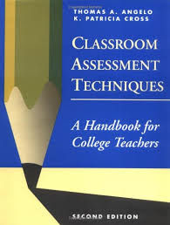
Classroom Assessment Techniques (CATs)
Most widely-known formative assessments
Angelo and Cross (1993) arguably most-cited
Notes:
CATs often considered synonymous with formative assessment
Though formative assessment is an approach, and CATs are techniques/tools (e.g., summative assessments such as chapter/unit exams *can* be used as formative assessment)
We’ll be talking about CATs today

Slide 17
CATs
Why is using CATs important?
Opportunity to adjust teaching
This has been traditional focus
Opportunity to help students monitor and adjust learning strategies
(Steadman & Svinicki, 1998)
Notes:
Steadman & Svinicki (1998) point out that traditionally, the focus of CATs has been on the instructor – CATs are a mechanism for teachers to monitor and adjust their teaching
CATS present opportunities for students to THINK ABOUT THEIR THINKING / LEARN ABOUT THEIR LEARNING / KNOW WHAT THEY KNOW
metacognition
However, CATs can also serve as a mechanism for students to get practice at (and develop the habit of) monitoring and adjusting their learning
When the teacher frequently prompts the student to think about their learning, they may begin to develop the habit of doing so on their own
These are skills that students can take with them to other learning situations

Slide 18
Implementation
Be explicit
What we are doing (specific assessment)
Why we are doing it
(Simpson-Beck, 2011; Steadman, 1998)
Notes:
HOWEVER,
Students seem not to get as much benefit from CATs when their attention is not directed to think about their learning
(They don’t necessarily transfer what they’ve learned about their learning)
Steadman & Svinicki (1998): Instructors often assume that just using a CAT in class improves student learning, when they likely need to be much more explicit
Deeprose & Armitage (2004): Explicit explanation from instructor helps instructor to be aware of changes in students’ learning/performance

Slide 19
Examples of CATs
Background Knowledge Probe
Minute Paper
Muddiest Point
Directed Paraphrasing
Instructional Feedback
(Angelo & Cross, 1993)
Notes:
With those guidelines in mind, let’s talk about some specific CATs that you might consider implementing in your courses

Slide 20
Background Knowledge Probe
Purpose: Assess prior knowledge of a topic
How it works:
Ask open-ended or MC questions prior to presenting information on a new topic
All students answer on paper, via clickers, etc.
Helps determine where to start teaching
We conducted this assessment a few minutes ago!
(Angelo & Cross, 1993)
Notes:
Helps determine where to start teaching
Also help students think about what they do and do not know as they jump into a new topic – what they need to especially pay attention to

Slide 21
Minute Paper
Purpose: Assess recall and understanding
How it works:
Last few minutes of class
Students answer, “What was the most important thing you learned in this class/chapter/unit?”
On paper, turn in
Instructor reviews and at next class can clarify, etc.
(Angelo & Cross, 1993; Cross, 1998)
Notes:
Can also ask “What is the biggest question you still have about this lesson/material?”

Slide 22
Muddiest Point
Purpose: Assess recall and understanding
How it works:
Students answer, “What was the muddiest point in the _____?”
Lecture, assignment, chapter, etc.
Instructor can address most prevalent points of confusion
Immediate (in-class) -or-
end of class and clarify at beginning of next class
(Angelo & Cross, 1993; Mosteller, 1989)
Notes:
Developed by Harvard statistics profsesor Frederick Mosteller (1989)

Slide 23
Directed Paraphrasing
Purpose: Assess application skills
How it works:
Students convey lesson concepts to a specific audience
In their own words
(Angelo & Cross, 1993)
Notes:
Example: Imagine you are working with an educational program for new parents. Explain to a new parent how their responsiveness to their infants’ cues helps the infants’ development of self-regulation.

Slide 24
Instructional Feedback
Purpose: Assess learner reactions to instruction
How it works:
Students respond to question(s) about how the class is taught
Via e-mail, electronic survey, or other method
Often anonymous
Perhaps especially helpful for graduate student instructors?
(Angelo & Cross, 1993)
Notes:
Example question to ask: What is one small change I could make that would help you to learn more effectively in this class?
You don’t have to wait until end-of-semester formal evaluations to get feedback on your teaching!

Slide 25
Research on CATs
Lots of qualitative research (e.g., Byon, 2005; Gaddert, 2003; Steadman, 1998; Winstone & Millward, 2012)
Perceptions of effectiveness
affect regarding courses
faculty/student attitudes
Less quantitative research (Cottell & Harwood, 1998; Short & Martin, 2012; Simpson-Beck, 2011)
Course outcomes; mixed results
Notes:
Focus of Qualitative Research (from Simpson-Beck, 2011)
3. surveys of student and/or faculty opinions assessing the effectiveness of CATs on student learning and/or teaching (Byon, 2005; Kelly, 1991, 2005; Rouseff-Baker and Holm, 2004;
Schwarm and VanDeGrift , 2002; Soetaert, 1998; Steadman, 1998);
4. student surveys on how CATs improved student course satisfaction (i.e. affective stance, Byon, 2005);
5. surveys of faculty attitudes toward the use of CATs in the classroom (Gaddert, 2003).
Qualitative research generally very positive / in favor of CATs (part of why they’re so popular)
Quantitative Research
Short & Martin (2012) DID find improvement in final course grades b/t CAT and no CAT, but other studies did not
Mixed results a function of methodology issues? Lots of variation in methodology across studies – a real challenge with classroom-based research

Slide 26
Research on CATs
Recommendations:
Be explicit in explaining what/how/why
Students get most benefit in learning strategies (Steadman & Svinicki, 1998)
Helps increase instructor awareness of student changes (Deeprose & Armitage, 2004)
Notes:
Students seem not to get as much benefit from CATs when their attention is not directed to think about their learning
(They don’t necessarily transfer what they’ve learned about their learning)
Steadman & Svinicki (1998): Instructors often assume that just using a CAT in class improves student learning, when they likely need to be much more explicit
Deeprose & Armitage (2004): Explicit explanation from instructor helps instructor to be aware of changes in students’ learning/performance

Slide 27
Closing Remarks
Revisit goal: build up your teaching toolbox
Flexible tools
Implement in any class, throughout semester
Ease of use

Slide 28
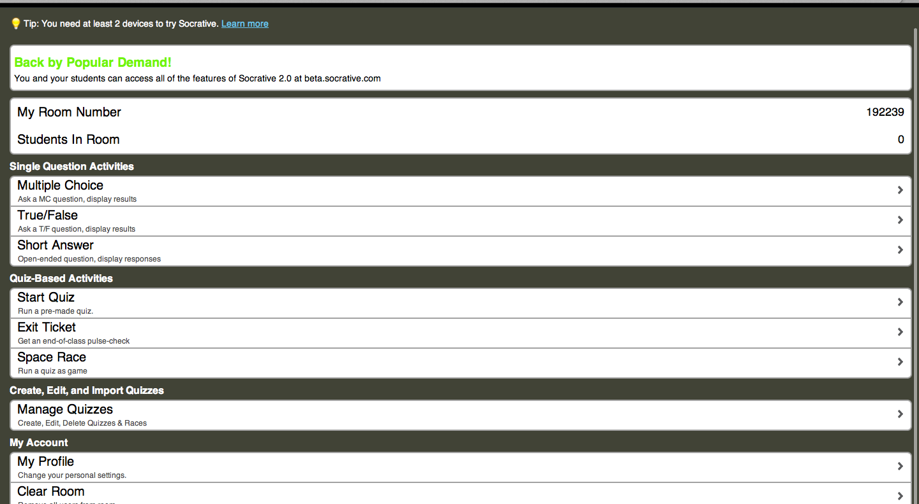
Additional Resources
Socrative.com
Notes:
www.socrative.com is another web-based polling system that instructors can use in the classroom to administer formative assessments.
More teaching-oriented than PollEverywhere.
Students can identify themselves; tracks responses; can download responses in Excel (for easy importing into gradebook, etc.).

Slide 29
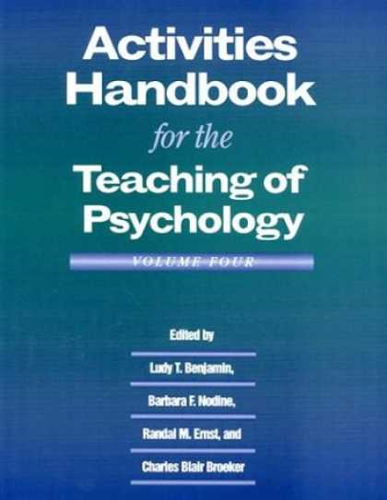
Additional Resources
Notes:
Another good source for graduate students and new faculty is the APA’s Activities Handbook for the Teaching of Psychology.
Has over 80 activities, some of which have been included in our presentation. The activities are grouped by topic - cover research methods and statistics, biopsychology and animal behavior, sensation and perception, etc.

Slide 30
References
Angelo, T. and Cross, K. P. (1993). Classroom assessment techniques: A handbook for college teachers. San Francisco, CA: Jossey-Bass.
Benson, T. A., Cohen, A. L., & Buskist, W. (2005). Rapport: Its relation to student attitudes and behaviors toward teachers and classes. Teaching Of Psychology, 32(4), 237-239. doi:10.1207/s15328023top3204_8
Buskist, W., & Davis, S. F. (2006). Handbook of the teaching of psychology. Malden, MA: Blackwell Publishing. doi:10.1002/9780470754924
Byon, A.S. (2005). Classroom assessment tools and students’ affective stances: KFL classroom settings. Language and Education, 19(3), 173–93.
Cottell, P., & Harwood, E. (1998). Do classroom assessment techniques (CATs) improve student learning? New Directions for Teaching and Learning, 75, 37–46.
Deeprose, C., & Armitage, C. (2004). Reports: Giving formative feedback in higher education. Psychology Learning & Teaching, 4(1), 43-46. doi:10.2304/plat.2004.4.1.43
Gaddert, B. K. (2003). Improving graduate theological instruction: Using classroom assessment techniques to connect teaching and learning. Teaching Theology and Religion, 6(1), 48–52.
Keengwe, J., & Belamaric Wilsey, B. (2012). Online graduate students' perceptions of face-to-face classroom instruction. International Journal Of Information And Communication Technology Education, 8(3), 45-54, doi:10.4018/jicte.2012070106
Legg, A. M., & Wilson, J. H. (2009). E-mail from professor enhances student motivation and attitudes. Teaching Of Psychology, 36(3), 205-211. doi:10.1080/00986280902960034

Slide 31
References
Murphy, M., & Valdéz, C. (2005). Ravaging resistance: A model for building rapport in a collaborative learning classroom. Radical Pedagogy, 7(1). Retrieved from http://www.radicalpedagogy.org/radicalpedagogy94/Ravaging_Resistance__A_Model_for_Building_Rapport_in_a_Collaborative
_Learning_Classroom.html
Murphy, E. & Rodriguez-Manzanares, M. A. (2008). Contradictions between the virtual and physical high school classroom: A third-generation activity theory perspective. British Journal of Educational Technology, 39(6), 1061-1072.
Short, F., & Martin, J. (2012). Who wants to be a psychology graduate? Impact of formative multiple-choice review questions on summative assessment performance. Psychology Learning & Teaching, 11(2), 218-227.
Simpson-Beck, V. (2011). Assessing classroom assessment techniques. Active Learning In Higher Education, 12(2), 125-132. doi:10.1177/1469787411402482
Steadman, M. (1998). Using classroom assessment to change both teaching and learning. New Directions for Teaching and Learning, 75, 23–35.
Steadman, M., & Svinicki , M. (1998). CATs: A student’s gateway to better learning. New Directions for Teaching and Learning, 75, 13–20.

Slide 32
References
Wei, C., Chen, N., & Kinshuk. (2012). A model for social presence in online classrooms. Educational Technology Research And Development, 60(3), 529-545. doi:10.1007/s11423-012-9234-9
Winstone, N., & Millward, L. (2012). Reframing perceptions of the lecture from challenges to opportunities: Embedding active learning and formative assessment into the teaching of large classes. Psychology Teaching Review, 18(2), 31-41.

Slide 33
Contact Information
Shana Southard-Dobbs, M.S.
shanasouthard-dobbs@my.unt.edu
Elizabeth Jenkins, M.S.
elizabethjenkins@my.unt.edu

